Slide 1
Need CE credit for this
session?
Please don’t forget to
scan in to have your
attendance tracked.

Slide 2
Ecological momentary assessments (EMA) to measure ACT processes and behavioral health across populations
Chair: Javier Rizo, University of Washington
Speakers: Ethan Moitra, Brown University
Angela Cathey, Wichita State University
Javier Rizo, University of Washington
Jennifer Villatte, University of Washington
Discussant: Mike Levin, Utah State University
Notes:
Welcome to the last day of the ACBS World Conference, and thank you for coming.
I’ll go ahead and briefly introduce our speakers and discussants for today’s symposium:
We have joining us from the east coast, Ethan Moitra, Assistant Professor from Brown University’s Department of Psychiatry and Human Behavior
In addition, from the midwest we have Angela Cathey, Doctoral Candidate at Wichita State University’s Department of Psychology
I’m Javier Rizo, a Research Coordinator at the University of Washington here in Seattle in the department of Psychiatry & Behavioral Sciences. Along with me is Jennifer Villatte, Assistant Professor in the department.
Last but not least, we have Mike Levin, Assistant Professor from Utah State University’s Department of Psychology as our discussant
With that, we’ll go ahead and get started…

Slide 3
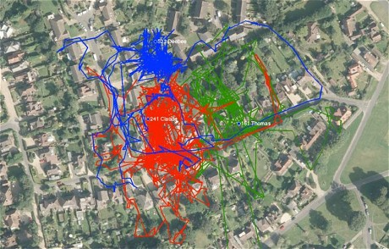
Contextual Behavioral Science & EMA
EMAs as a more contextual alternative to assessment
Increased ecological validity
Reduced recall bias
Repeated sampling
Notes:
Before we start the presentations I’m going to provide a brief introduction to ecological momentary assessments, commonly referred to as EMAs, and also known as experience sampling methods.
EMAs are a range of methods which have a few common qualities that make them suitable for contextual behavioral science. These include:
Collecting data in subject’s natural environment, enhancing ecological validity
Assessing experience and behavior in the moment, reducing recall bias
Repeatedly sampling over time, measuring changes in behavior across contexts
EMAs provide an alternative assessment methodology to global self-report measures, direct observation, or collateral information which often have serious flaws associated with them. Armed with more precise measurement, expanded scope of use, and increasing levels of depth (such as measuring physiological states) EMAs have the potential to revolutionize contextual behavior science.
They are more contextual by their nature, with the ability to assess both internal experiences and environmental events. In being able to measure both subjective and objective data, it’s increasingly possible to better understand the antecedents and consequences of behavior as they occur.
Although unified in certain ways, EMAs vary in their design, schedule, content, and technology used depending on the target behavior being assessed.
(Image – GPS for cat wandering the neighborhood – telegraph.co.uk)

Slide 4
Trends in EMAs
- Emerging technologies influence on the development of EMAs
Increasing adoption of mobile devices
Ecological Momentary Intervention (EMI)
Notes:
EMAs have been around since the 70s, starting with written diaries as subjects were prompted by beepers and PDAs. The increasing capability and availability of mobile technologies such as smartphones and wearable devices provide innovative tools increasing the precision, scope, and depth of EMAs.
One particular innovation resulting from this is the emergence of the ecological momentary intervention (known as EMI). With the increasing adoption of mobile technologies, mHealth interventions on the go become more feasible.
The strength of EMIs are similar to EMAs, in that interventions are delivered in the natural environment, where therapists or other healthcare providers are often not around. EMAs and EMIs delivered in conjunction is a relatively new frontier, which promises a wider reach for us to promote behavioral health.

Slide 5
Symposium Agenda
9:00 – Introduction
9:05 – Using mobile technology to examine contextual predictors of outcomes in individuals experiencing psychosis following a hospital discharge
9:20 – Using ecological momentary assessment to examine impact of self-regulation choice on affect
9:35 – Design and integration of an ecological momentary assessment and intervention of ACT for smoking cessation in those with serious mental illness
9:50 – Contextual behavioral assessment of psychological flexibility using wearable sensors
10:05 – Discussion
Notes:
From the various talks you’ll hear during this symposium, you’ll see how EMAs are currently being utilized in contextual behavioral science research.
I hope you have a chance to learn more about these exciting methods, and see how they can be leveraged to better understand processes relevant to ACT and behavioral health.
So without further ado, I’ll go ahead and hand it over to Ethan to give our first talk…

